Slide 1
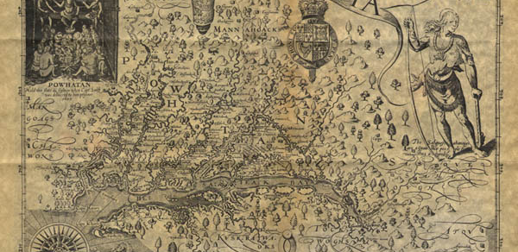
Jamestown colony

Slide 2
Richard Hakluyt, A Discourse of Western Planting (London, 1584)
Promises:
Diversify English economy
New products
Pillage Spanish
Taxes
Spread English brand of Christianity
Place to send undesirables
Native peoples will welcome English rule

Slide 3
Push – Pull Migration
What factors pushed English settlers to come to the “New World”?
What factors pulled English settler to the “New World”?
Which factors was most important?

Slide 4
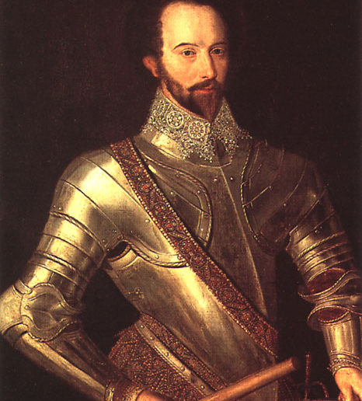
Roanoke
England’s first attempt at New World colonizing
Walter Raleigh
“Lost Colonists”

Slide 5
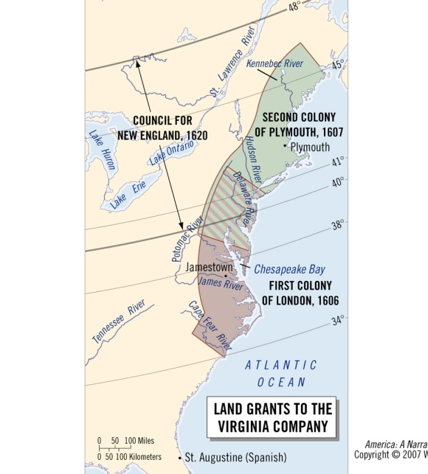
Virginia Company of London
Royal charter (patent)
Joint-stock company
Colonists all company employees (men)
Major stockholders stayed in England
Business venture
Profit motive outweighed everything else

Slide 6
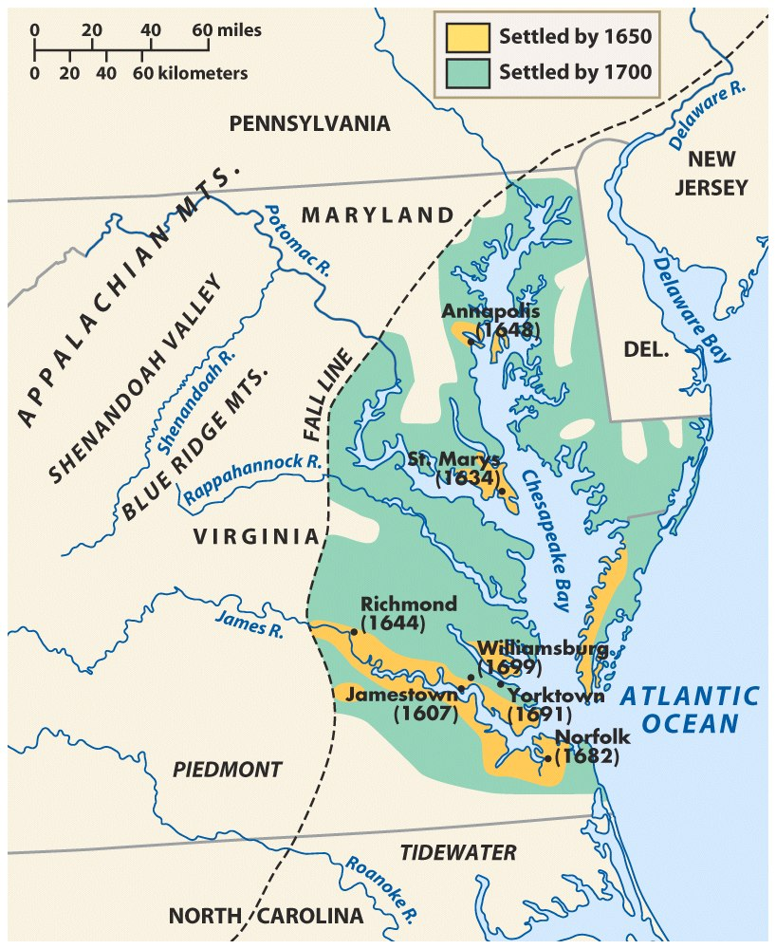
Jamestown, est. 1607
First successful English colony in North America
Aims:
Establish base in North America
Trade with local Indians for food
Obtain/pillage for furs and precious metals
Result: most colonists soldiers, adventurers, and craftsmen rather than farmers or fisherman

Slide 7
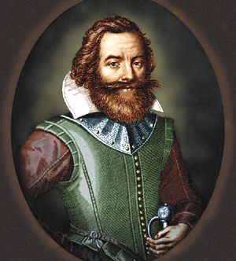
Jamestown – experiences don’t meet expectations
Location
Protected by water
Surrounded by James River and swamps
Locals
Algonquians led by Powhatan
Sickness
Little trade = little food
Low morale
Held together by John Smith, Indian generosity, and a constant flow of supplies and colonists from England.

Slide 8
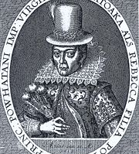
Importance of Pocahontas
Powhatan’s daughter
John Smith’s life
Married John Rolfe
Symbol of assimilation

Slide 9
Three Phases of VA Co. of London
Phase One (1607-9):
Hopes of quick wealth dashed
mica-speckled dirt
no Indian labor
Starvation, disease, internal conflict
John Smith’s iron hand
900 settlers arrived, 60 survived
Word on the street is that Jamestown a complete and utter failure

Slide 10
Phase Two (1609-18)
Reform
Governor & Advisory council (Company out of touch)
Tighter regulations
Conciliatory Indian policy
Pocahontas kidnapped
New recruitment strategy
Farmers instead of adventurers
Investment opened to public
Lotteries
“free land” offerings
Headright system

Slide 11
Phase Three (1619-24)
Company allows for representative assembly in 1619
Colonists no longer company employees
Between 1619 and 1624, 4,500 new settlers arrive in Virginia, including women
Recipe for sustainability
Immediate land ownership
Local government

Slide 12
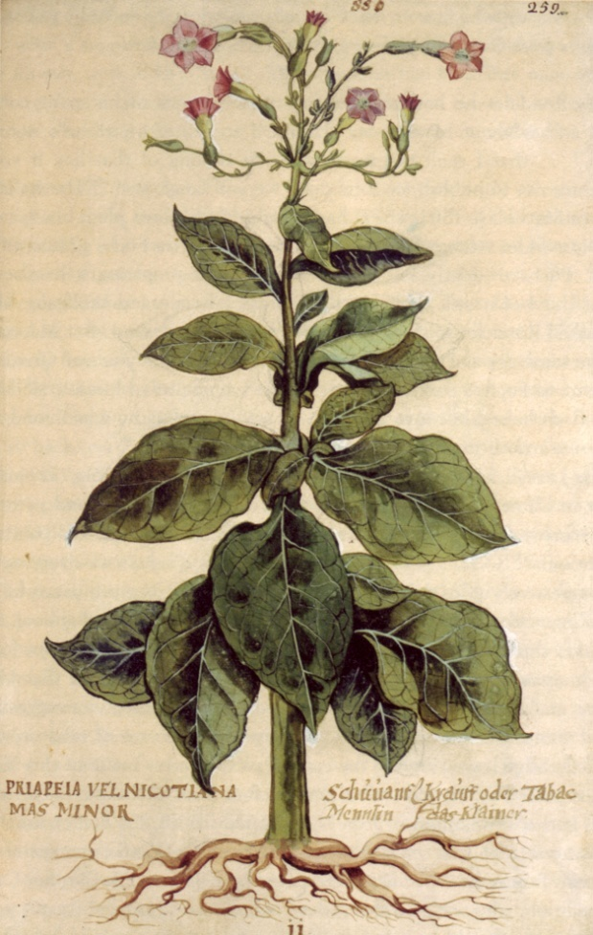
From “Starving Time” to Profitability.
Tobacco
Smoking craze sweeps England
John Rolfe
Experimentation with West Indian plants
“Virginian”
1614: 200,000 lbs.
1638: 3 million lbs.

